Slide 1
Managing Interactive Technology for Youth Well-Being
Rick Ferkel, PhD
Central Michigan University

Slide 2
Introduction
Why is this topic important?
  20-year-old experiment
  Rapid changes since the 2010’s
  Crippling youth to be healthy adults
What I need from you:
  Evaluate the routines, times, and habits of your child(ren), home, and self
  Think about changes that could be made to impact those routines, times, and habits for the development of your child(ren)

Slide 3
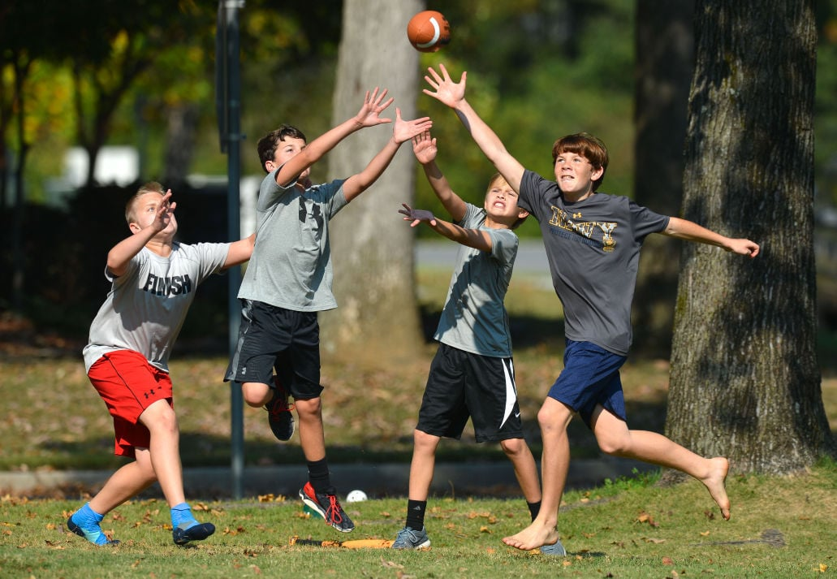


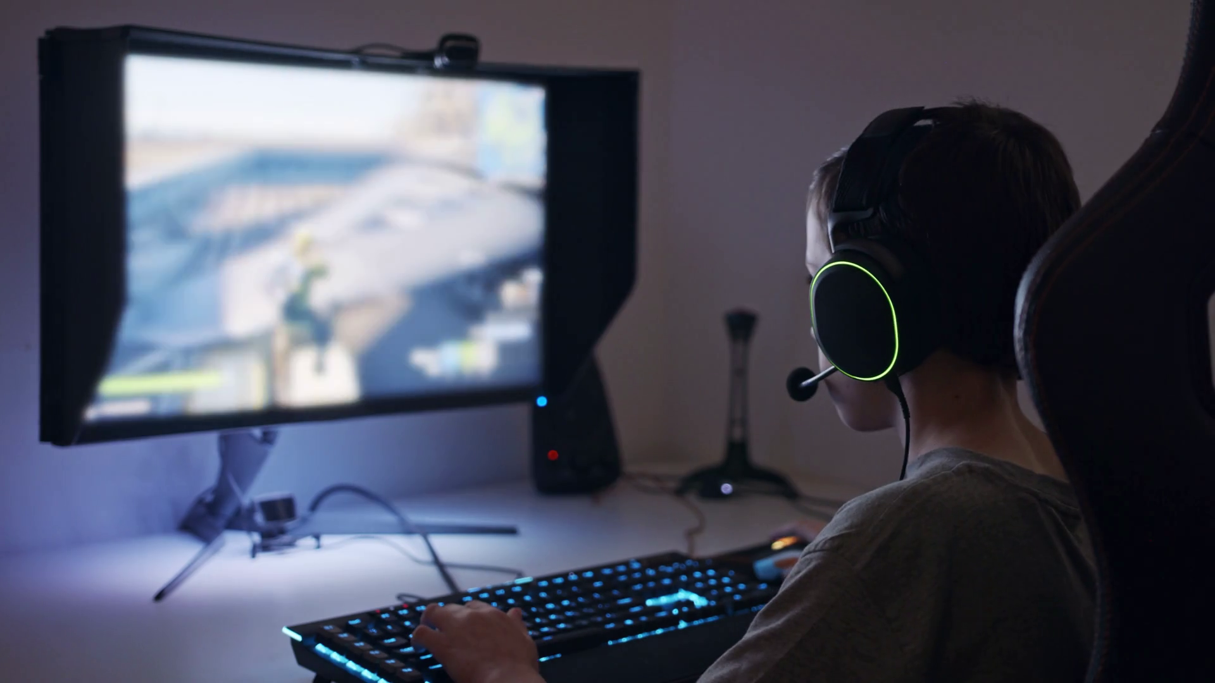
Which One is Your Son(s)?

Slide 4
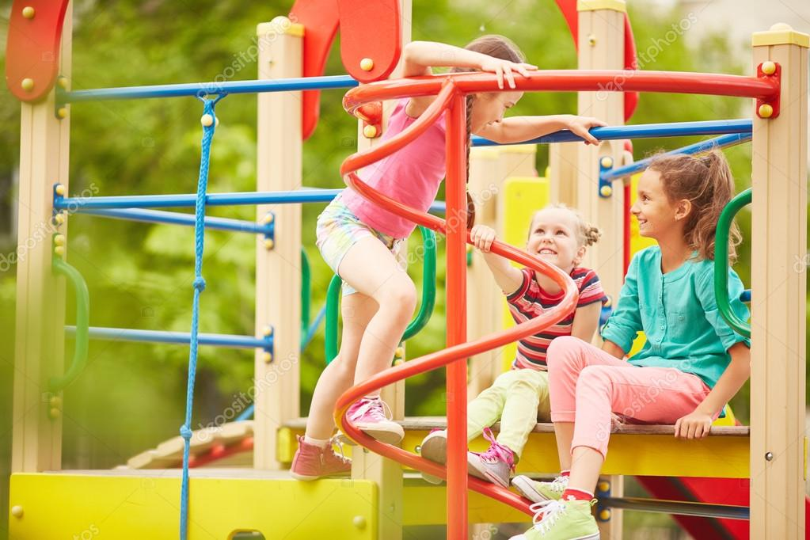



Which One is Your Daughter(s)?

Slide 5

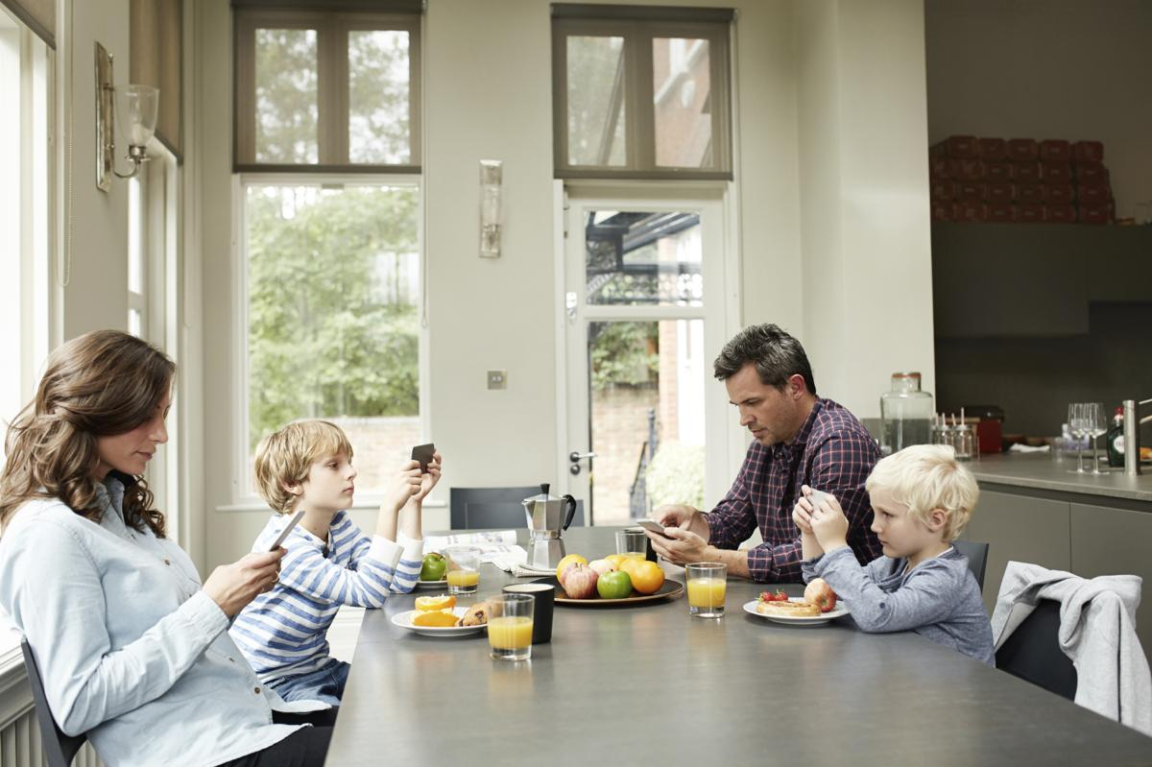
Which One is Your Family?

Slide 6
Current State of Kids Well-Being

Slide 7
Physical Health

Slide 8
Youth Physical Activity Rates
Only 24% of 6–17-year-olds meet the 60-minutes of daily physical activity (US Report Card on PA for Youth, 2024)
  34% of 6–11-year-olds
  15% of 12–17-year-olds
  We now have PA recommendations for 3–5-year-olds (2018, DHHS)

Slide 9
Youth Obesity
Obesity rates over the last 50 years
  3% (1970) to 21% in youth 6-19 years
Roughly a 5% increase over the last decade
Nearly one in three adolescents meet the criteria for prediabetes
(CDC, 2022)

Slide 10
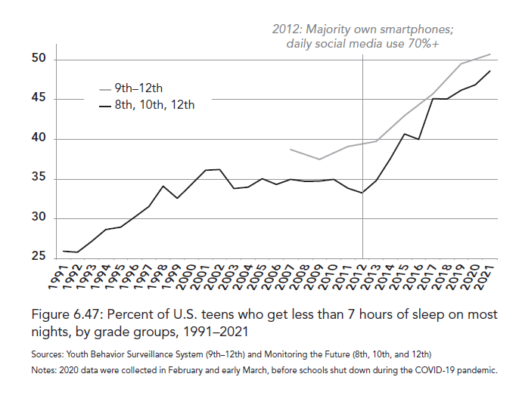
Sleep
Sleep deprived youth
  1-2: 34.5% < 11, recommended (11-14 hours)
  3-5: 34.7% < 10, recommended (10-13 hours)
  6-12: 38.4% < 9, recommended (9-12 hours)
  13-14: 57.8% < 8, recommended (8-10 hours)
  15-18: 77.9% < 8, recommended (8-10 hours)
  (CDC, 2022)

Slide 11
Social Health

Slide 12
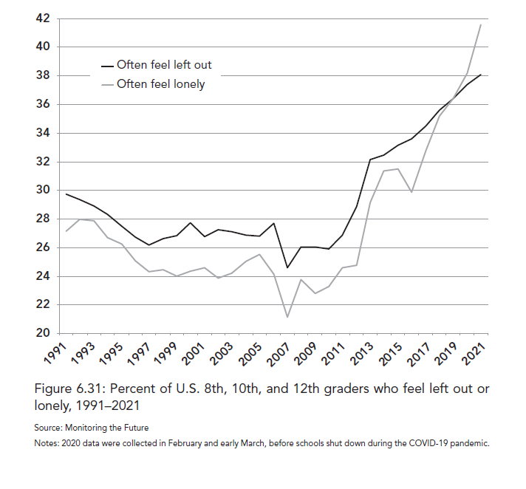
Teens: Loneliness (pre-Covid)

Slide 13
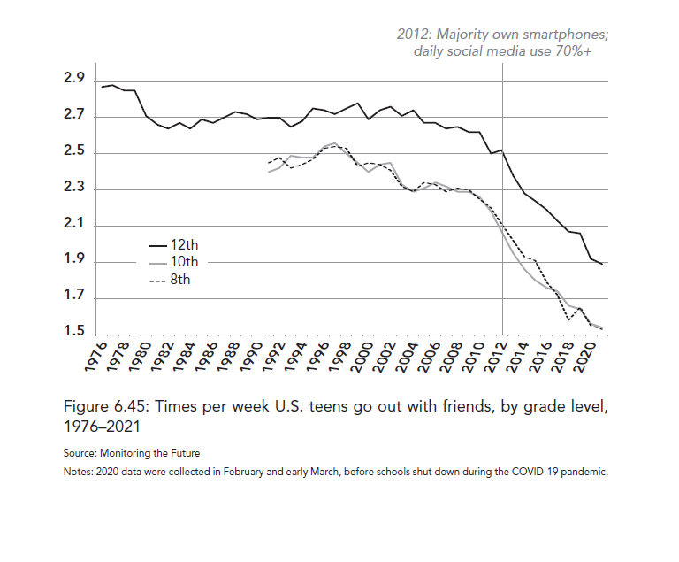
Going out with Friends

Slide 14
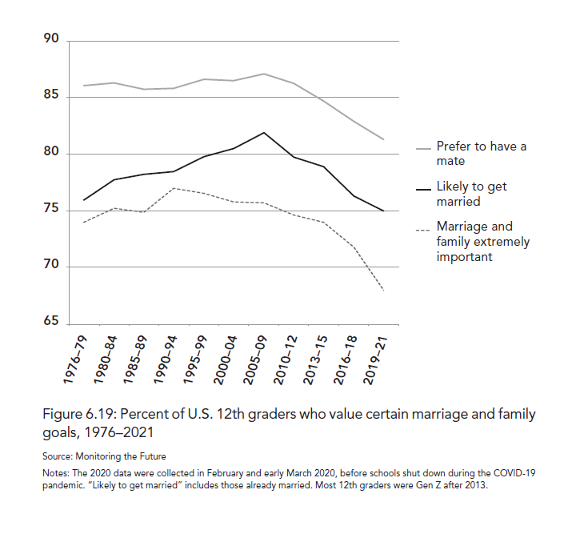
12th Graders Value on Marriage and Family

Slide 15
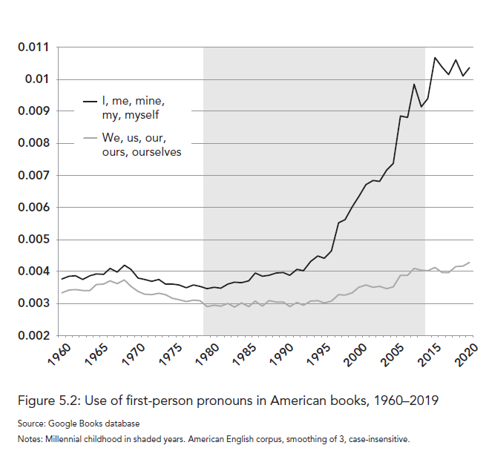
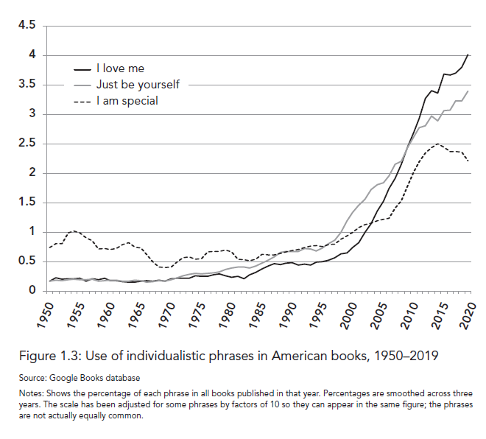
Increase in Self-Focus: I, Me, My; I Love Me

Slide 16
Faith and Cultural Beliefs

Slide 17
Changing Cultural Shift from God/Religion to Self
1960 – 92% identified as Christians and 98% believed in God
2021 – 69% identified as Christians, 21% identified as no religion, and 81% believed in God (Gallup, 2021)

Slide 18
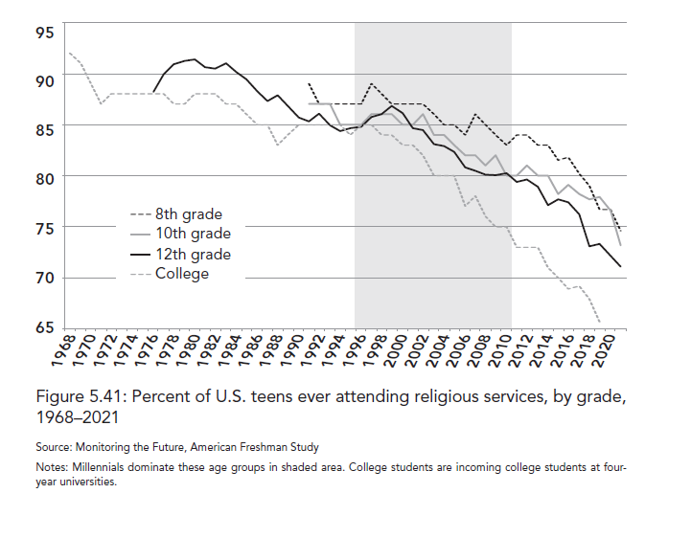
Teens: Church Attendance
(Roughly 8% drop over 40 years, Roughly 8% drop since 2010)

Slide 19
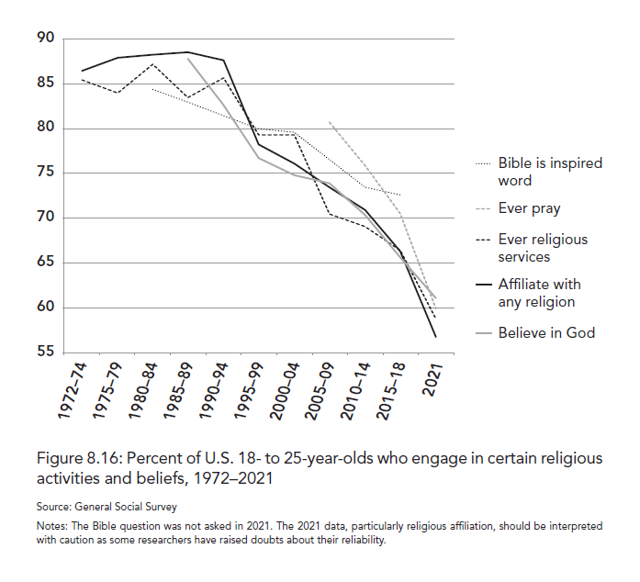
Young Adults: Belief in God and Practices
(Roughly 15% drop over 40 years, Roughly 13% drop since 2010)

Slide 20
Mental Health

Slide 21
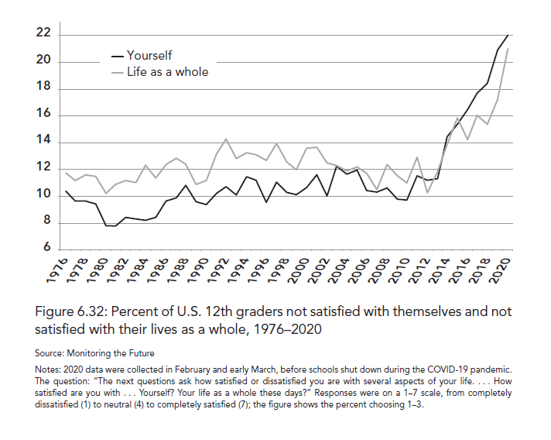
12th Graders: Not Satisfied with Life/Themselves (pre-Covid)

Slide 22
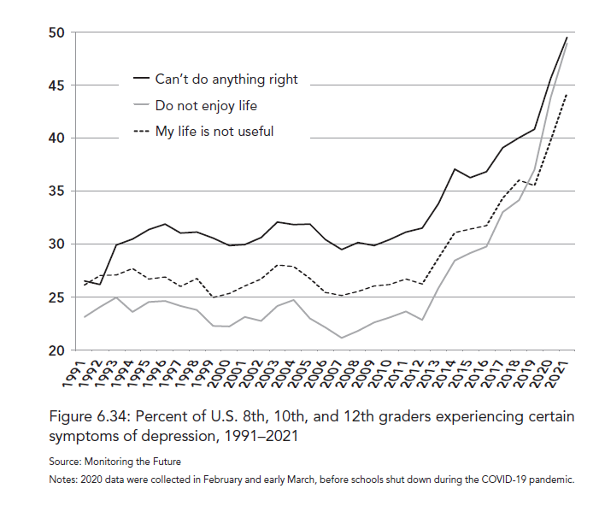
Teens: Symptoms of Depression (pre-Covid)

Slide 23
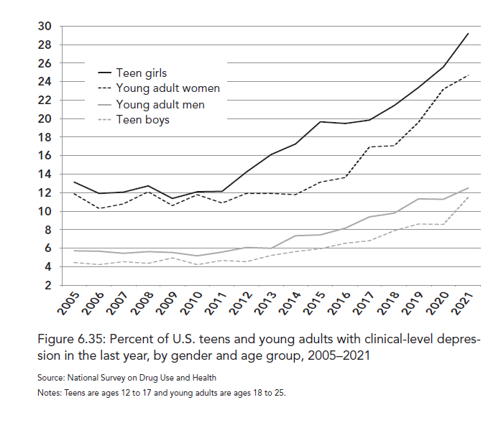
Teens and Young Adults: Clinical-Level Depression

Slide 24
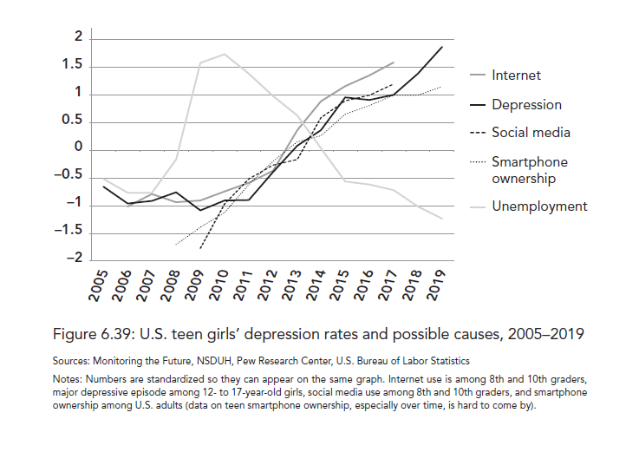
Teen Girls Depression Rates and Technology Use

Slide 25
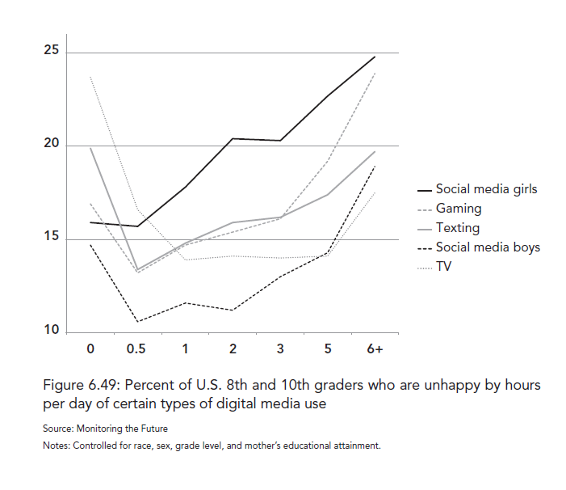
8th and 10th Graders:
Unhappy by hours of Technology Use

Slide 26
Technology’s Progression
Cable: 60% by 1992 (Change influencer)
Internet: Over 50% by 2001 (Increased influence)
Myspace (2003), Facebook, YouTube (2005), Smart phone, Twitter (2007), Instagram (2010), Snapchat (2014), TikTok (2016)
Video Games: Over 100-billion-dollar industry (phone, computer, gaming systems)
Daily social media use in Teens: Over 70% by 2012 (Game Changer)
Smart Phone: Over 50% of population by 2013 (Population Changer)
2023 – Roughly 95% of adults and teens own a smart phone

Slide 27
Recreational Screen Time Use
0-2 Years
  Roughly an hour, higher around 2 years (equals 15 days in a year)
3-7 Years
  Around 3 hours (equals 46 days in a year, 1/8)
8-10 Years
  6 hours (equals 91 days in a year, 1/4)
11-14 Years
  9 hours (equals 137 days in a year, 1/3)
15-18 Years
  7.5 hours (equals 114 days in a year, almost 1/3)
Adults
  5-7 hours
  (CDC, 2023)

Slide 28
Sphere of Influence
Parents, family, friends, teachers, coaches, church/Bible, local community
Increased technology use:
  Anything that mankind can imagine
  Social contagions/psychological epidemics
    Loneliness, depression, suicidality, sexuality confusion, civil unrest, etc.
Being introduced to life issues is a progression in the real world, it is sporadic in the virtual world

Slide 29
Family Interactions
Takes away true deep relationships
  Talking
  Spending quality time
  Eating together
Everyone can be in the same house, but in different rooms, on different technology
Social media does not actually connect us
  Lonelier than we have ever been
Self-focus/individualistic constant consumption makes it hard to have strong meaningful relationships
  Ex., marriage

Slide 30
Reward Center/Dopamine Cycle
What is dopamine?
  Associated with reward (build up to the reward)/motivation and craving (wanting)
Immediate Gratification vs. Delayed Gratification
  Pleasure without the requirement for pursuit
    Activates parts of the brain (e.g., amygdala, hippocampus) that act upon desire and emotion
    Strengthens pathways in the brain to just act on emotion
  Work and dedication to reach a goal/end product
    Work (school, job, home, sports, etc.), exercise, discipline in other areas (e.g., eating)
    Activates the prefrontal cortex (frontal lobe)
      Responsible for self-control/discipline and other executive functions such as critical thinking, decision making, memory, and creativity

Slide 31
Specific Impact on Girls
Social Media
  Girls are wired for communion
    Having relationships with others, communicating
  Always comparing (not good enough)
    e.g., Photo shop comparisons of peers/self
  Striving for likes, devasted when not liked
  Open for harassment/ridicule in a multitude of ways, by others and self
  A key element to sky rocketing depression, anxiety, self-harm, and suicidality

Slide 32
Specific Impact on Boys
Video games and pornography
  Virtual world, not real
    Boys are wired for agency
      Feeling of command in one’s life, my role makes a difference, competing, achieving
    Alternative to sports, conquering, creating, and sexual fulfillment/relationships
      Hinders risk, physical activity, testosterone, development
    Instead of taking on life when they are young, boys are in a fake world of agency, which leaves many lost with limited drive to succeed and become men
      Increase in “Failure to Launch”
        Drivers license, job, living arrangements, marriage, etc.

Slide 33
Technology–Free Play: Trade-Off
Stay inside in the air conditioning, eating ice-cream, and being on the technology of choice?
or
Go outside in the heat, come up with something to do (possibly with other kids), and then physically do it?
  Which is the path of least resistance/easier?
  Think about the impact on work ethic, mental fortitude, drive, etc.
Four-hours of recreational technology leads to eight-hours of lost developmental time.
Question: Do you see as many kids out on their own playing as you did 10, 20, 30, 40 years ago? How does it compare to when you were a kid?

Slide 34
Importance of Free Play
Physical fitness and overall health
Problem solving
Conflict resolution
Creativity
Cognition/memory/focus
Challenge/risk
Mental fortitude/resiliency/grit
True self-confidence/efficacy
Enjoyment/fun

Slide 35
Exercise is Medicine
Key Benefits of Exercise and PA for 21st Century Youth
  Influences: mood, anxiety, depression, sleep, cognition, energy
Lack of PA and sleep, abundance of technology, and poor nutrition
  Over-consuming of dopamine
  Pharmaceuticals
Evaluate and change these before any medications

Slide 36
Parental Fear Driven by Technology
1980s – child abduction, major news stories
Media focus on the outliers (fear/emotion)
  Unwarranted fear of death/major injury and abductions
    Non-family abductions account for .3% of missing children cases (National Center for Missing and Exploited Children, 2020)
    A child would need to be outside, unattended, for 750,000 years for it to statistically happen (LetGrow, ND)
Safetyism: the belief system in which safety is a sacred value which exceeds everything else, no matter how unlikely or trivial the potential danger.

Slide 37
Anti-Fragility
Safetyism is in direct opposition to anti-fragility.
  Butterfly effect, bio-dome effect
Over protecting of the real world and under protecting the virtual world. (Haidt, 2024)
Defend Mode instead of Discover Mode

Slide 38
Recommendations and Strategies

Slide 39
Critical Period of Impact
0-2 years
  Over stimulation hinders brain development
  Natural hands-on experiences drive growth and development
60% of brain development/learning takes place by age 6
  Interacting with others and different environments are greatly needed
10-15 years of age is a critical developmental period (onset of puberty)
  The brain is highly influenced
    Teen reward pathways are 2-4 times stronger than adults
    Majority of adult addictions start in the teen years (up to 90%)
  Development of the pre-frontal cortex
    Experiences need to be focused more on developing this area

Slide 40
Basic Recommendations
< 2
  Try to eliminate all technology, even electronic toys
3-6
  Hour or less (TV, movies), more concerned professionals say no screen time
  No video games, social media, internet exploration (e.g., YouTube)
7-12
  No more than 2 hours
    No video games (definitely none before 10, 5th grade)
      Hour or less other wise
    No social media
13-18
  No concrete recommendations, many say 2 hours
  After 1-hour the research indicates a statistical significance of negative impact on well-being

Slide 41
Strategies
No technology in the bedroom (TV’s, computers, video games)
  Okay for phones to talk during set hours
    Consider getting a house phone in some shape or form
At bedtime, keep phones in another spot, not in bedroom
  Parents room, kitchen/other room (temptation higher)
No technology 1-2 hours before bed
  Even more important if not getting appropriate sleep/can’t sleep
No technology before school, church, etc. (this includes TV)
No technology during designated family time (e.g., dinner, game night), this is for parents also

Slide 42
Strategies
Have content filters on all devices (computers, phones, tablets)
  Specifically for pornography and depression/suicidality themes
  Teens can usually get around these
Make a contract before allowing social media
  Parents have access to periodically check communication
  Question: Do we really need social media?
Tablets and Computers
  No tablets 12 and under (definitely not before 10, 5th grade)
  Use the family desktop or use laptop in open areas

Slide 43
Phone Recommendations
No phone before 10 (5th grade)
  If felt needed, flip phone
10-14 (5th-8th grade): Basic Phone
  Phones that look like Smart Phones are available
  Pictures/videos: Be aware, this is a time where sexting (i.e., nude self pictures) and pornography sharing starts to intensify
No Smart Phone until 9th grade
  Ideally 11th grade

Slide 44
Social Media Recommendations
No social media until 11th grade
    Time use limits (recommend no more than an hour per day on social media)
    Shut it down early in the night to make sure they sleep
      Keep it out of the bedroom during bedtime
    Have a contract, you have access to it
    Teach them how to use wisely going into adulthood
    Model how to use wisely yourself

Slide 45
Free Play Recommendations
Let them go outside on their own
  This is going to be hard for many parents because of fear/worry/concern
No Technology
Kids get bored inside
If they are bored inside
They will go outside: It’s good for them to be bored!
Child development flourishes
  Does not mean there won’t be risk
    https://x.com/SteveInmanUIC/status/1775193535391604791
  But the rewards statistically far outweigh the risk

Slide 46
What Can Parents Do
How to get there example:
  Start early, 3–5-year-olds (no organized sport before 6, let them play)
    Family walks through neighborhoods and town, bike rides, go to the park, etc.
    Let them climb and jump
    Discuss how to be wise more so than safe
      e.g., look both ways, reading signs, “what if” scenarios, strategies to get higher without falling
  6-8, they can start to venture on their own
    Continue to do things with them to train
    But let them start to branch out
      E.g., ride bikes/walk to friends, park, school, relatives, etc.
  By 9, they should be able to handle much more freedom with practical parameters
    Let them start going to the store and getting things you need (e.g., groceries)
    Riding bikes to farther distances
    Meeting up with friends outside

Slide 47
Parents Coming Together: “Parent Packs”
“Parent Packs”
  Recommendations:
    No tablets until 7th grade
    No video games until 7th grade
    No smart phones until 9th grade
    No social media until 11th grade
    When friends are over, if phones are present, all phones go in a basket
    Allow unsupervised play/interaction
  If many do it, makes it easier to develop kids and have less push back

Slide 48
Family Strategies
Have fun and close relationships in your home regardless of age
  Play board/card games
  Go for walks
  Sports, outdoor activities, hobbies, etc. (do not need to be expensive)
  Read stories together
  Talk to each other
  Church, devotions, Bible reading
  Garden, outside projects, etc.
  Chores, jobs, work
Don’t let your phone/technology use impact your family’s well-being

Slide 49
Concluding Thoughts
We are in a 20-year experiment never seen in human history: The outcomes are not good.
We don’t need to go cold turkey, but we have to incrementally change what we are currently doing.
We must come together as a community of parents, educators, and adults and make basic packs to help each other and our kids.
Stay strong, hold the line, be intentional: it will allow your kids to flourish in the future even if they aren’t happy in the moment.

Slide 50
Contact Information
rick.ferkel@cmich.edu
Cell: 419-957-8436
Book Recommendations:
  The Anxious Generation: How the Great Rewiring of Childhood is Causing an Epidemic of Mental Illness (Haidt, 2024)
  Balanced and Barefoot (Hanscom, 2016)
www.anxiousgeneration.com/
https://letgrow.org/
https://screenstrong.org/
https://www.afterbabel.com/

